Slide 1
GPS Time Synchronization
Project By:
Suhas N Bharadwaj, PES1UG21EC299
III Semester, F Section

Slide 2
Agenda
Purpose of clock synchronization
Network Time Protocol (NTP)
Purpose of GPS in time keeping
Accuracy of synchronization
Implementation
Demonstration
Scope for Improvement

Slide 3
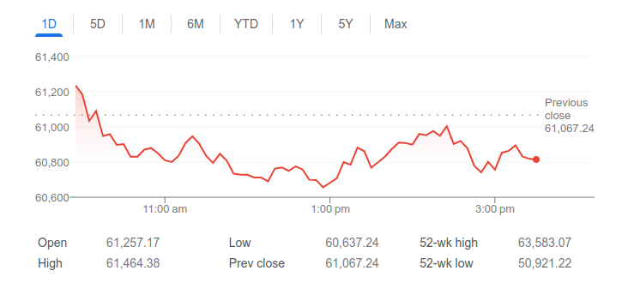
Introduction
When stocks are traded in the market, it is not simply which share is sold but also when it is sold.
If communication servers are not synchronized, it could appear as if information was received from the past or even the future.

Slide 4
Why synchronize clocks?
All clocks drift regularly, usually a few seconds per day due to quality of the clock, manufacturing tolerances, stability of the power supply or other environmental factors.
Banks, stock markets, social media platforms or any other client - server communication is primarily tracked with their time stamps.
All transactions are critically dependent on synchronized clocks since it is not simply which transaction occurs but also when it occurs.

Slide 5
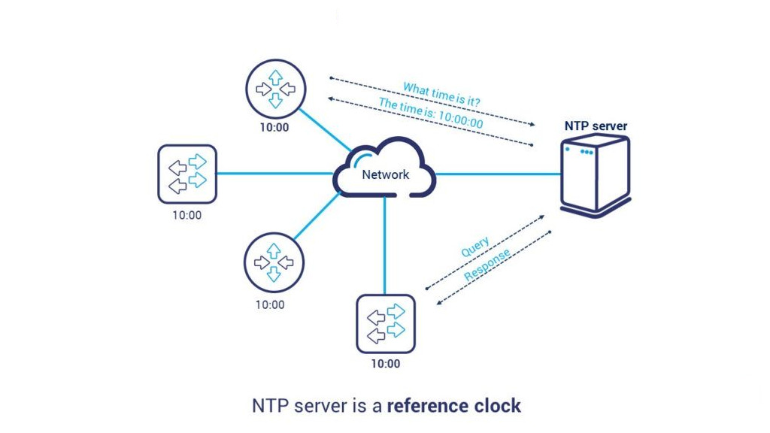
How are clocks synchronized? (NTP)
Typically, a server is used as the reference time source and all the other servers on the same network are synchronized using the Network Time Protocol (NTP).
A consumer device communicates with such a server on a daily basis and synchronizes its own clock to that time.

Slide 6
In NTP, a reference clock is chosen which is presumed to be highly accurate. This is assigned a stratum value or layer value of 0.
Any other clocks synchronized to the reference clock is assigned stratum 1 and other cascading clocks are assigned increasing stratum values.
Stratum values range between 0 and 15 and any value greater than 15 indicates an inaccurately synchronized clock.

Slide 7
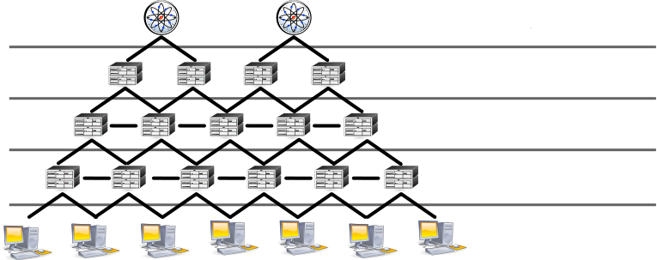
Stratum 0
Stratum 1
Stratum 2
Stratum 3
Stratum 4

Slide 8
Why use GPS?
While NTP works well within one network, if time had to be synchronized between multiple data centers with their own NTP servers, it is unreliable.
To remedy this, they are each synchronized to GPS clocks which are themselves synchronized to a master atomic clock.
GPS satellites carry atomic clocks on them making them very accurate time sources which can be accessed from multiple locations.

Slide 9
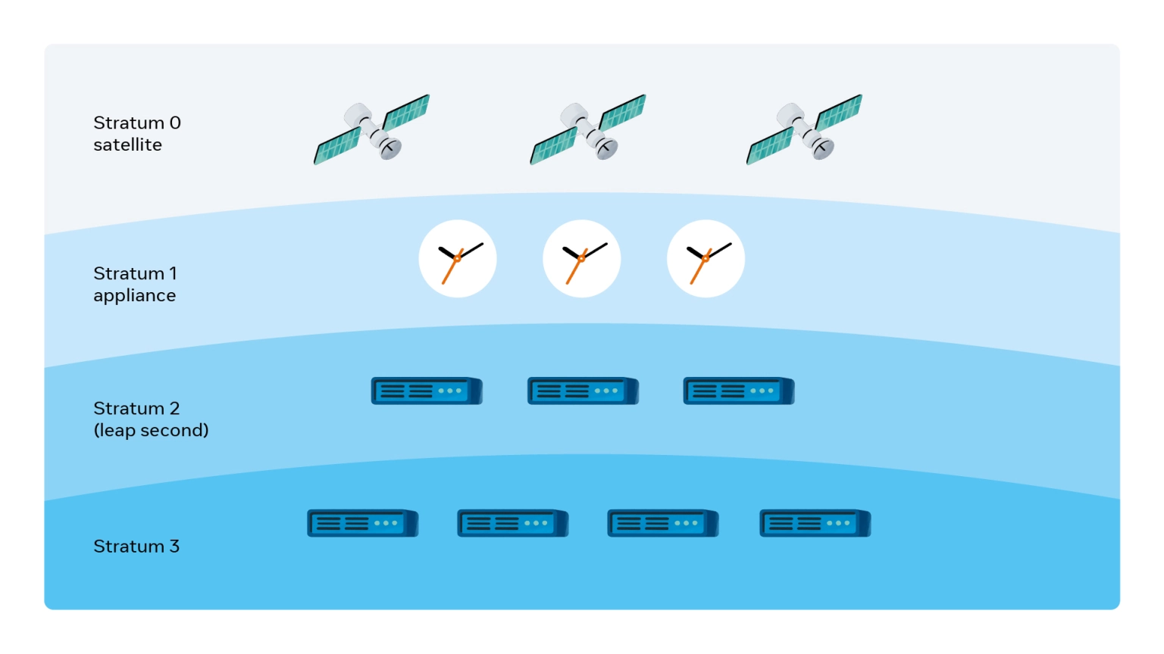
Since the GPS clocks are highly accurate, the NTP servers can then be synchronized to a fairly high level of accuracy. This allows for consumer devices to be “accurate enough”.

Slide 10
How accurate?
Servers that handle billions of transactions a day are synchronized to within 1ns of UTC.
To achieve this, they make use of highly specialized hardware such as local atomic clocks and GPS receivers.
Consumer devices are usually accurate to 1s of UTC.

Slide 11
Which time zone to use?
Transactions occur all over the globe and making use of time zones for each location increases overhead and complexity for the time synchronization.
The Coordinated Universal Time or UTC is a successor to GMT. GPS satellites are synchronized to UTC. All servers are also synchronized to UTC.
The time offsets for the time zones may be applied for the consumer but all transactions and events are tracked using UTC to make them agnostic of the time zone.
Notes:
I mentioned UTC earlier, what is UTC... To make it time zone agnostic.

Slide 12
Communication with GPS Satellites - NMEA Sentences
GPS Satellites send data as NMEA sentences, originating from the National Marine Electronics Association of the US.
Each sentence is 68 characters long and contains information from the satellite such as the date, time, latitude, longitude, altitude, dilution of precision and more.
To obtain the time, the following NMEA sentences are used: GPGGA, GNGGA, GPRMC, GNRMC.
Notes:
All sentences starting with GP are GPS satellites from the US while the sentences starting with GN are part of the GNSS which include IRNSS (Indian regional satellite navigation system), Galileo from the European Union and Chinese Baidou satellites.
New title: Communication with GPS Satellites

Slide 13
Sample GPGGA/GNGGA sentence:
$--GGA,hhmmss.ss,llll.ll,a,yyyyy.yy,a,x,xx,x.x,x.x,M,x.x,M,x.x,xxxx
hhmmss.ss = UTC of position llll.ll = latitude of position a = N or S yyyyy.yy = Longitude of position a = E or W x = GPS Quality indicator (0=no fix, 1=GPS fix, 2=Dif. GPS fix) xx = number of satellites in use x.x = horizontal dilution of precision x.x = Antenna altitude above mean-sea-level M = units of antenna altitude, meters x.x = Geoidal separation M = units of geoidal separation, meters x.x = Age of Differential GPS data (seconds) xxxx = Differential reference station ID

Slide 14
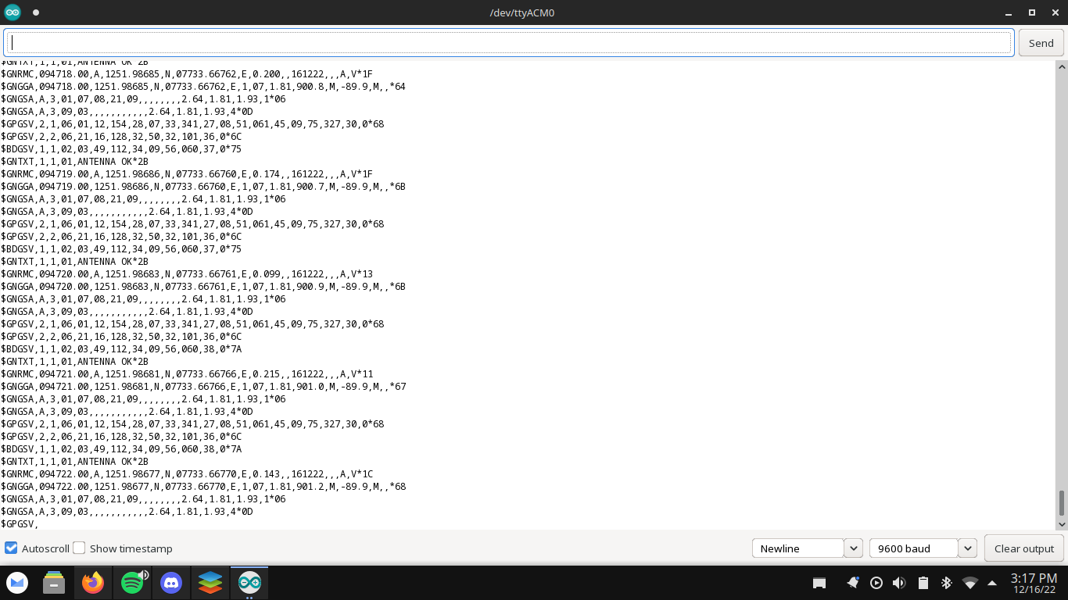

Slide 15
Implementation

Slide 16
Block Diagram
GPS Receiver
Controller
RTC

Slide 17
Components
DS3231 serves as a low-cost but highly accurate Real Time Clock (RTC).
Neo-6m GPS receiver fetches the GPS data.
Arduino Uno is used as a microcontroller to set up the logic and interface between the GPS receiver and RTC.

Slide 18
Connections and Configurations
Both the GPS receiver and the DS3231 RTC send serial data at baud rates of 9600pps (pulses per second).
The RTC is connected to the SDA and SCL ports on the arduino.
The GPS receiver is connected to pins 3 and 4 which are also programmed to receive serial data.

Slide 19
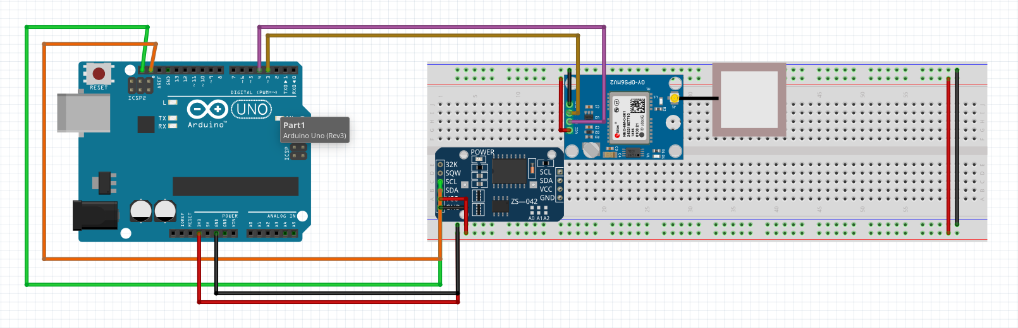
Schematic
Neo-6m GPS Receiver
Arduino Uno
DS3231 RTC

Slide 20
Demonstration

Slide 21


Slide 22
Scope for Improvement
Processing delays are not accounted for.
Accuracy is $$±$$1s. This can be further improved to a few microseconds using a receiver whose 1pps output is available.
Due to the usage of breadboard and jump cables, loose contacts and wire breakages are recurrent.
Notes:
New title: Scope for improvement

Slide 23
Other Solutions
The Open Time Server (OTS) is an open source project led by Meta to develop a “time card” that can be installed in servers to synchronize the time.
They make use of atomic clocks and GPS receivers on each card.

Slide 24
Bibliography
NMEA sentences: http://aprs.gids.nl/nmea/
RTC data sheet: https://www.digikey.com/en/datasheets/maxim-integrated/maxim-integrated-ds3231-ds3231s
GPS data sheet: https://pdf1.alldatasheet.com/datasheet-pdf/view/1283987/U-BLOX/NEO-6M.html
TinyGPS++: https://github.com/mikalhart/TinyGPSPlus
RTCLib: https://github.com/adafruit/RTClib

Slide 25
Thank You
Notes:
Thank you slide

Slide 26
Appendix

Slide 27
Component Specifications
A DS3231 Real Time Clock (RTC) is used due to its 3.3V operating voltage and is very accurate to ±2ppm of the clock frequency at temperatures between 0C and 40C, while being a low cost device.
Since it is accurate to 2ppm, the time drift per day is 86400 * 2x10^-6 = 172.8ms. In a week it would have drifted by 1.21s.
The NEO-6m GPS receiver is used due to its operating voltage being between 2.7V and 3.6V. It is highly sensitive (to -161dBm) and it takes around 30s to 2 minutes to start obtaining satellite data.
An Arduino Uno is used as the microcontroller as it is quick enough to handle the task at hand and posseses both analog and digital inputs. It obtains the serial data from the GPS receiver and it updates the RTC if the time has drifted.

Slide 28
Libraries Used
TinyGPS++ provides the TinyGPSPlus class which contains the functions for parsing the NMEA sentences and also validate the data in the sentences.
RTCLib provides classes for multiple RTCs including DS3231 and the DateTime class which stores all the date and time information from the RTC.

Slide 29
List of Commonly Used NMEA Sentences
$GPBOD - Bearing, origin to destination
$GPBWC - Bearing and distance to waypoint, great circle
$GPGGA - Global Positioning System Fix Data
$GPGLL - Geographic position, latitude / longitude
$GPGSA - GPS DOP and active satellites
$GPGSV - GPS Satellites in view
$GPHDT - Heading, True
$GPR00 - List of waypoints in currently active route
$GPRMA - Recommended minimum specific Loran-C data
$GPRMB - Recommended minimum navigation info
$GPRMC - Recommended minimum specific GPS/Transit data
$GPRTE - Routes
$GPTRF - Transit Fix Data
$GPSTN - Multiple Data ID
$GPVBW - Dual Ground / Water Speed
$GPVTG - Track made good and ground speed
$GPWPL - Waypoint location
$GPXTE - Cross-track error, Measured
$GPZDA - Date & Time
Notes:
NMEA sentence list

Slide 30
Daylight Savings
Daylight savings are used in cold countries so that darkness comes up at a later clock time.
In the spring, clocks are set back by an hour resulting in a 23 hour day.
In the winter, clocks are set forward by an hour resulting in a 25 hour day.
Hence the total number of hours in a year does not change.
UTC experiences no daylight savings and it is not accounted for in time synchronization.

